Slide 1
Liang-Barsky Line Clipping Algorithm
Computer Graphics
1

Slide 2
Liang-Barsky Line Clipping
Line clipping approach is given by the Liang and Barsky is faster then cohen- sutherland line clipping.
Which is based on analysis of the parametric equation of the line which are,
𝒙 = 𝒙_{𝟏} + 𝒕∆𝒙
𝒚 = 𝒚_{𝟏} + 𝒕∆𝒚
Where 𝟎 ≤ 𝒕 ≤ 𝟏 ,∆𝒙 = 𝒙_{𝟐} − 𝒙_{𝟏} and ∆𝒚 = 𝒚_{𝟐} − 𝒚_{𝟏}.
if t=0 then x=x1,y=y1(starting point) If t=1 then x=x2,y=y2(ending point)
From point clipping we already know;
To find weather given point is inside or outside the clipping window we use following inequality:
^{𝒙}𝒘𝒎𝒊𝒏 ^{≤ 𝒙 ≤ 𝒙}𝒘𝒎𝒂𝒙^{, 𝒚}𝒘𝒎𝒊𝒏 ^{≤ 𝒚 ≤ 𝒚}𝒘𝒎𝒂𝒙
𝒙_{𝒘𝒎𝒊𝒏} ≤ 𝒙_{𝟏} + 𝒕∆𝒙 ≤ 𝒙_{𝒘𝒎𝒂𝒙}, 𝒚_{𝒘𝒎𝒊𝒏} ≤ 𝒚_{𝟏} + 𝒕∆𝒚 ≤ 𝒚_{𝒘𝒎𝒂𝒙}
(x2, y2)
^{(x}wmax, ^{y}wmax)
^{(x}wmin, ^{y}wmax)
Clipping Window
^{(x}wmin, ^{y}wmin)
^{(x}wmax, ^{y}wmin)
(x1, y1)

Slide 3
Liang-Barsky Line Clipping
𝒙_{𝒘𝒎𝒊𝒏} ≤ 𝒙_{𝟏} + 𝒕∆𝒙 ≤ 𝒙_{𝒘𝒎𝒂𝒙}, 𝒚_{𝒘𝒎𝒊𝒏} ≤ 𝒚_{𝟏} + 𝒕∆𝒚 ≤ 𝒚_{𝒘𝒎𝒂𝒙}
Can be written as:
𝒕∆𝒙 ≥ 𝒙_{𝒘𝒎𝒊𝒏} −𝒙_{𝟏},
𝒕∆𝒙 ≤ 𝒙_{𝒘𝒎𝒂𝒙} − 𝒙_{𝟏},
𝒕∆𝒚 ≥ 𝒚_{𝒘𝒎𝒊𝒏} −𝒚_{𝟏},
𝒕∆𝒚 ≤ 𝒚_{𝒘𝒎𝒂𝒙} −𝒚_{𝟏},
left right bottom top
(x
y (x y
wmin, wmax) wmax, wmax)
Clipping Window
Represent all equations in ≤ form
−𝒕∆𝒙 ≤ 𝒙_{𝟏} − 𝒙_{𝒘𝒎𝒊𝒏}
𝒕∆𝒙 ≤ 𝒙_{𝒘𝒎𝒂𝒙} − 𝒙_{𝟏}
- 𝒕∆𝒚 ≤ 𝒚_{𝟏}
𝒕∆𝒚 ≤ 𝒚_{𝒘𝒎𝒂𝒙} −𝒚_{𝟏}
^{(x}wmin, ^{y}wmin)
^{(x}wmax, ^{y}wmin)
^{− 𝒚}𝒘𝒎𝒊𝒏

Slide 4
Liang-Barsky Line Clipping
−𝒕∆𝒙 ≤ 𝒙_{𝟏} − 𝒙_{𝒘𝒎𝒊𝒏}
𝒕∆𝒙 ≤ 𝒙_{𝒘𝒎𝒂𝒙} − 𝒙_{𝟏}
- 𝒕∆𝒚 ≤ 𝒚_{𝟏}
𝒕∆𝒚 ≤ 𝒚_{𝒘𝒎𝒂𝒙} −𝒚_{𝟏}
^{− 𝒚}𝒘𝒎𝒊𝒏
General form for equations is: t*pk ^{≤ q}k, where k=1,2,3,4(left, right, bottom & top edge)
p₁= −∆𝒙, q₁= 𝒙_{𝟏} − 𝒙_{𝒘𝒎𝒊𝒏} ,
p₂=
p₃=
p₄=
t = q₁/p₁ t = q₂/p₂ t = q₃/p₃ t = q₄/p₄
∆𝒙, − 𝒙_{𝟏},
^{(x}wmin, ^{y}wmax) ^{(x}wmax, ^{y}wmax)
^{q}2^{= 𝒙}𝒘𝒎𝒂𝒙
−∆𝒚 , q₃= 𝒚_{𝟏}
Clipping Window
^{− 𝒚}𝒘𝒎𝒊𝒏,
∆𝒚 ,
^{q}4^{= 𝒚}𝒘𝒎𝒂𝒙
− 𝒚_{𝟏},
^{(x}wmin, ^{y}wmin)
^{(x}wmax, ^{y}wmin)

Slide 5
Liang-Barsky Line Clipping Algorithm
Parametric definition of line
xmin ≤ x1 + t Δx ≤ xmax ymin ≤ y1 + t Δy ≤ ymax
Δx=x2-x1 Δy=y2-y1 0 ≤ t ≤ 1
x2, y2
x1, y1
Initializations
Set viewport points as xmin, xmax, ymin and ymax
Set the line with 2 points A(x1,y1) and B (x2,y2)
Set line intersection parameters tentry (t1) = 0.0 and tleaving (t2) = 1.0
Calculations
Find dx = x2 – x1 and dy = y2 – y1
Update t1 or t2 depending upon dx or dy

Slide 6
Liang-Barsky Line Clipping Algorithm
Step 1 :
Set line intersection parameters tentry (t1) = 0.0 and tleaving (t2) = 1.0
Step 2 :
Obtain pk and qk for k =1: 4
Edge & K value | p | q | t
Left k=1 | p1 = -dx | q1 = x0 - xwmin | t = q1/p1
Right k=2 | p2 = dx | q2 = xwmax - x0 | t = q2/p2
Bottom k=3 | p3 = -dy | q3 = y0 - ywmin | t = q3/p3
Top k=4 | p4 = dy | q4= ywmax - y0 | t = q4/p4

Slide 7
Liang-Barsky Line Clipping Algorithm
Step 3 :
If pk = 0, the line is parallel to the corresponding clipping
boundary.
If pk = 0 and qk<0, the line is completely outside the boundary.
If pk = 0 and qk>=0, the line is inside the parallel clipping boundary.
(a)
(b)
Khushbu Maurya
7

Slide 8
Liang-Barsky Line Clipping Algorithm
Step 4 :
Using pk and qk (k =1 :4), find if the line can be rejected or intersection
parameters (t1 and t2) must be adjusted.
if pk < 0, update t1 as max[0, qk/pk] where k =1:4
if pk > 0, update t2 as min[1, qk/pk] where k =1:4 After the update,
If t1 > t2, reject the line
If t1 > 0, calculate new values of x1, y1
If t2 < 1, calculate new values of x2, y2

Slide 9
Liang-Barsky Line Clipping - Example
dx = P1x - P0x // Horizontal diff between P0 and P1
dx = x1 - x0 = 280-30 = 250
dy = P1y - P0y // Vertical diff between
dy = y1 - y0 = 160-20 = 140
P0 and P1 | 150 | 280, 160 P1(x1,y1)
70 | 60 | 230
P0(x0,y0) 30, 20
dx = 250 , dy = 140
Initially
tentry (t1) = 0.0 tleaving(t2) = 1.0

Slide 10
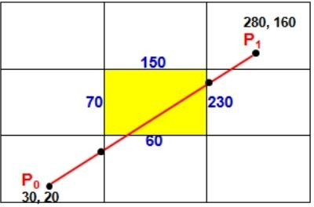
Liang-Barsky Line Clipping - Example
dx = 250
dy = 140
Left edge check:
p = -dx = -250
q = x0 - xmin = 30-70 = -40 t = q/p = 0.16
If p< 0 // update tentry (t1)
if t > t1 set t1 = t
-250 < 0 TRUE
check if t > t1 --> 0.16 > 0.0 TRUE
t1 = t
t1 = 0.16
 | 150 | 280, 160 P1
70 | 60 | 230
P0 30, 20 | Clipped | New t1 = 0.16 t2 = 1.0
t1 = 0.16 t2 = 1.0
Khushbu Maurya
10

Slide 11
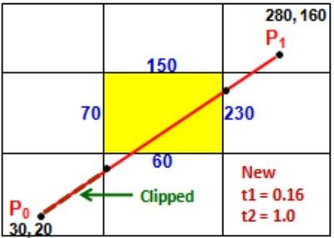
Liang-Barsky Line Clipping - Example
dx = 250
dy = 140
Right edge check:
p = dx = 250
q = xmax – x0 = 230-30 = 200 t
= q/p = 0.8
If p< 0 FALSE
If p > 0 // update tleaving (t2)
if t < t2 set t2 = t
250 > 0 TRUE
check if t < t2 ---> 0.8 < 1.0 TRUE t2 = t = 0.8
t1 = 0.16 t2 = 0.8
 | 150 | 280, 160 P1
70 | 60 | 230 Clipped
P0 30, 20 |  | New t1 = 0.16 t2 = 0.8

Slide 12
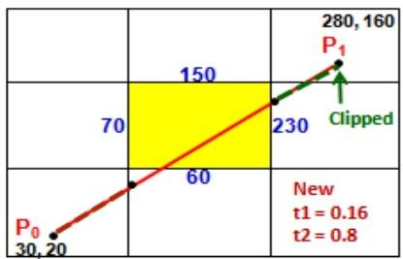
Liang-Barsky Line Clipping - Example
dx = 250
dy = 140
Bottom edge check:
p = -dy = -140
q = y0 - ymin = 20-60 = -40 t
= q/p = 0.2857
If p< 0 // update tentry (t1) if t
> t1 set t1 = t
-140 < 0 TRUE
check if t > t1 ----->
0.2857 > 0.16 TRUE
t1 = t----> t1 = 0.2857 t1 = 0.2857 t2 = 0.8
 | 150 | 280, 160 P1
70 | 60 | 230
P0 30, 20 | Clipped | New t1 = 0.29 t2 = 0.8

Slide 13
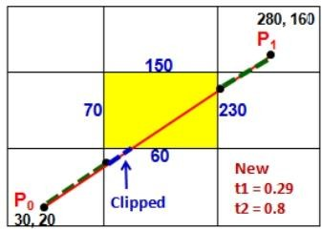
Liang-Barsky Line Clipping - Example
dx = 250
dy = 140
Top edge check:
p = dy = 140
q = ymax – y0 = 150 - 20 = 130 t
= q/p = 0.928
If p< 0 FALSE
If p > 0 // update tleaving (t2) if t
< t2 set t2 = t
140 > 0 TRUE
check if t < t2 -----> 0.928 < 0.8 FALSE
t1 = 0.2857 t2 = 0.8
 | 150 | 280, 160 P1
70 | 60 | 230
P0 30, 20 |  | No more clippings

Slide 14
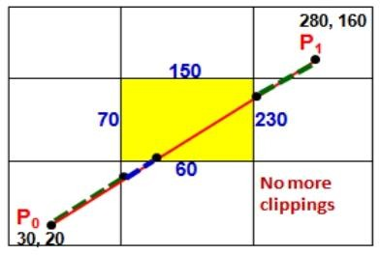
Liang-Barsky Line Clipping - Example
t1 = 0.2857 t2 = 0.8 dx =
250 dy = 140
if( tentry > 0.0 ) calculate new x0, y0 0.2857 >
0.0 TRUE
x0new x0new y0new y0new
= x0 + tentry *dx
= 30 + 0.2857 * 250
= 101.425 = y0 + tentry *dy
= 20 + 0.2857 * 140 = 60.0

Slide 15
Liang-Barsky Line Clipping - Example
t1 = 0.2857
dx = 250
t2 = 0.8
dy = 140
 |  |  | 280, 160
 |  |  | P1
 | 150 New |  | P ₁
 |  |  | 230
70
New P | 0
 |  | 60
P0 30, 20
if( tleaving < 1.0 ) calculate new x1, y1
0.8 > 0.0 TRUE
x1new x1new y1new y1new
= x0 + tleaving *dx
= 30 + 0.8 * 250 = 230
= y0 + tleaving *dy
= 20 + 0.8 * 140 = 132
Draw clipped line with the points A(x0new , y0new) and B(x1new , y1new)

Slide 16
Advantages of Liang-Barsky Line Clipping
More efficient.
Only requires one division to update 𝑡₁ and 𝑡₂.
Window intersections of line are calculated just once.
Khushbu Maurya

